Slide 1
Online-Trolling
STATUS-QUO:
Nowadays, a lot of cyberbullying and trolling on social media sites, there isn’t any specific dedicated system for particular social media platform to handle the criticism and trolling. We propose a solution which identifies the online troller/offender for Twitter and reports the user to the cyber-police, along with blocking/deleting the tweets.
Presented By - CodeHunters
College - Sardar Patel Institute of Technology, Andheri

Slide 2
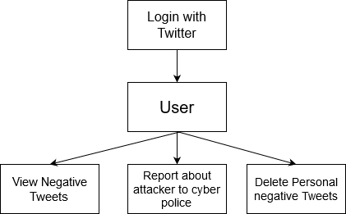
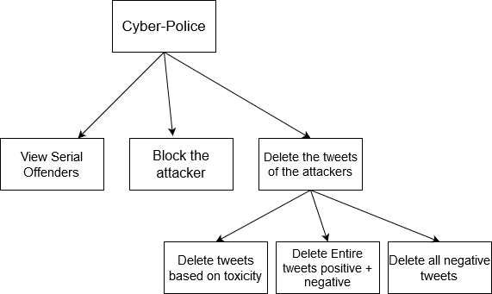
IDEATION / FLOW OF IDEAS
USER
User can register and login to the web application and enter the twitter details
User can check the number of negative/trolling comments against him
User can report the user or block the user and send the details of the person to cyber police for further investigation
User has an option to let his negative tweets get deleted in a single click after his approval, so that it won’t show on his profile
Cyber police has 3 options - to delete negative tweets from the attacker, to delete entire feed of the user consisting of both types of tweets and also can permanently block the user.
Police can also delete some specific tweets depending upon the toxicity of the tweet
Cyber-Police

Slide 3







TECHNOLOGY STACK
WEB APPLICATION USING DJANGO:
A user friendly system to know about the negative tweets from the attacker.
Client
Django
TWITTER AND APIS:
User accesses twitter and the apis which retrieve the information and data about the tweets, users, and related information
Twitter
Keras/Tensorflow
SENTIMENT ANALYSIS WITH ML:
Well trained model using ML Kit to predict the negative tweets and classify it to report the user
Python
LIBRARIES:
Twitter API v3, Pandas, LSTM for training the model
Cyber Police

Slide 4
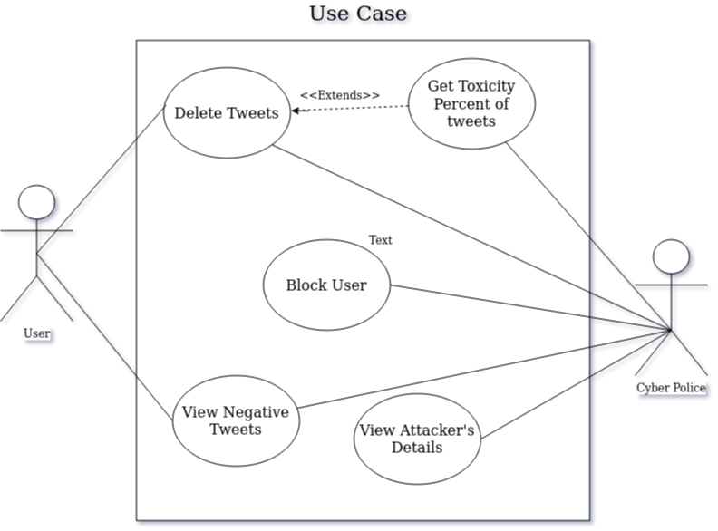
USE CASE

Slide 5
SHOWSTOPPERS/DEPENDENCIES
Showstoppers:
For user related functions access keys needs to be generated
Cyber police is needed for attackers IP tracking and details tracking
Dependencies:
Twitter Api V3
Machine Learning kit

Slide 6
THANK YOU!

